Slide 1
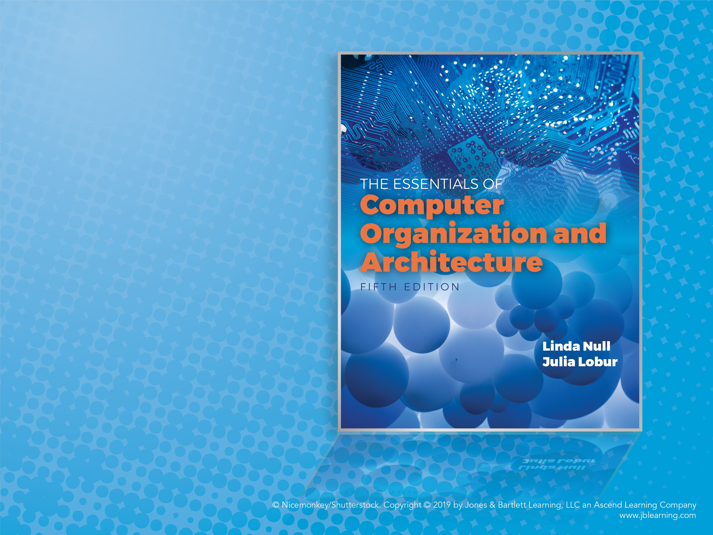
Chapter 7
Input/Output Systems

Slide 2
Objectives
Understand how I/O systems work, including I/O methods and architectures.
Become familiar with storage media, and the differences in their respective formats.
Understand how RAID improves disk performance and reliability, and which RAID systems are most useful today.
Be familiar with emerging data storage technologies and the barriers that remain to be overcome.

Slide 3
7.1 Introduction
Data storage and retrieval is one of the primary functions of computer systems.
One could easily make the argument that computers are more useful to us as data storage and retrieval devices than they are as computational machines.
All computers have I/O devices connected to them, and to achieve good performance I/O should be kept to a minimum!
In studying I/O, we seek to understand the different types of I/O devices as well as how they work.

Slide 4
7.2 I/O and Performance
Sluggish I/O throughput can have a ripple effect, dragging down overall system performance.
This is especially true when virtual memory is involved.
The fastest processor in the world is of little use if it spends most of its time waiting for data.
If we really understand what’s happening in a computer system we can make the best possible use of its resources.

Slide 5
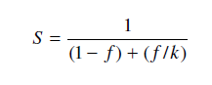
7.3 Amdahl’s Law (1 of 3)
The overall performance of a system is a result of the interaction of all of its components.
System performance is most effectively improved when the performance of the most heavily used components is improved.
This idea is quantified by Amdahl’s Law:
where S is the overall speedup;
f is the fraction of work performed by a faster component; and k is the speedup of the faster component.

Slide 6
7.3 Amdahl’s Law (2 of 3)
Amdahl’s Law gives us a handy way to estimate the performance improvement we can expect when we upgrade a system component.
On a large system, suppose we can upgrade a CPU to make it 50% faster for $10,000 or upgrade its disk drives for $7,000 to make them 150% faster.
Processes spend 70% of their time running in the CPU and 30% of their time waiting for disk service.
An upgrade of which component would offer the greater benefit for the lesser cost?

Slide 7
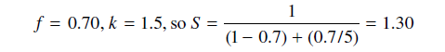
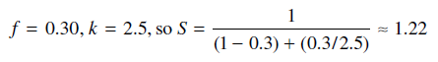
7.3 Amdahl’s Law (3 of 3)
The processor option offers a 30% speedup:
And the disk drive option gives a 22% speedup:
Each 1% of improvement for the processor costs $333, and for the disk a 1% improvement costs $318.
Should price/performance be your only concern?

Slide 8
7.4 I/O Architectures (1 of 16)
We define input/output as a subsystem of components that moves coded data between external devices and a host system.
I/O subsystems include:
Blocks of main memory that are devoted to I/O functions.
Buses that move data into and out of the system.
Control modules in the host and in peripheral devices
Interfaces to external components such as keyboards and disks.
Cabling or communications links between the host system and its peripherals.

Slide 9
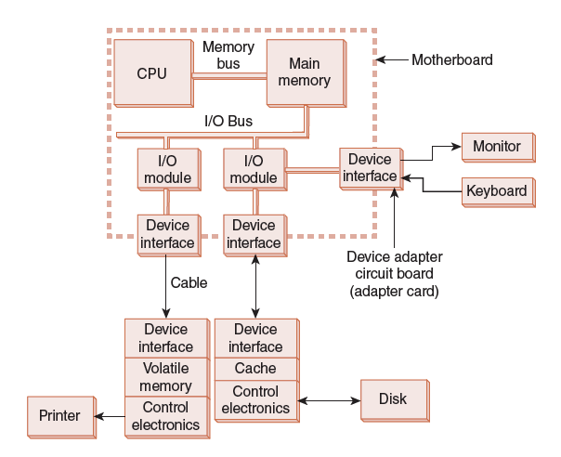
7.4 I/O Architectures (2 of 16)
This is a model I/O configuration.

Slide 10
7.4 I/O Architectures (3 of 16)
I/O can be controlled in five general ways.
Programmed I/O reserves a register for each I/O device. Each register is continually polled to detect data arrival.
Interrupt-Driven I/O allows the CPU to do other things until I/O is requested.
Memory-Mapped I/O shares memory address space between I/O devices and program memory.
Direct Memory Access (DMA) offloads I/O processing to a special-purpose chip that takes care of the details.
Channel I/O uses dedicated I/O processors.

Slide 11
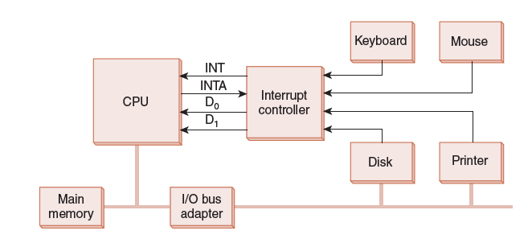
7.4 I/O Architectures (4 of 16)
This is an idealized I/O subsystem that uses interrupts.
Each device connects its interrupt line to the interrupt controller.
The controller signals the CPU when any of the interrupt lines are asserted.

Slide 12
7.4 I/O Architectures (5 of 16)
Recall from Chapter 4 that in a system that uses interrupts, the status of the interrupt signal is checked at the top of the fetch-decode-execute cycle.
The particular code that is executed whenever an interrupt occurs is determined by a set of addresses called interrupt vectors that are stored in low memory.
The system state is saved before the interrupt service routine is executed and is restored afterward.
We provide a flowchart on the next slide.

Slide 13
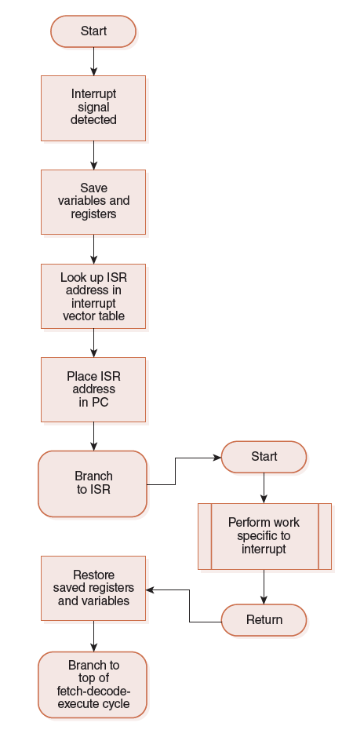
7.4 I/O Architectures (6 of 16)

Slide 14
7.4 I/O Architectures (7 of 16)
In memory-mapped I/O devices and main memory share the same address space.
Each I/O device has its own reserved block of memory.
Memory-mapped I/O therefore looks just like a memory access from the point of view of the CPU.
Thus the same instructions to move data to and from both I/O and memory, greatly simplifying system design.
In small systems the low-level details of the data transfers are offloaded to the I/O controllers built into the I/O devices.

Slide 15
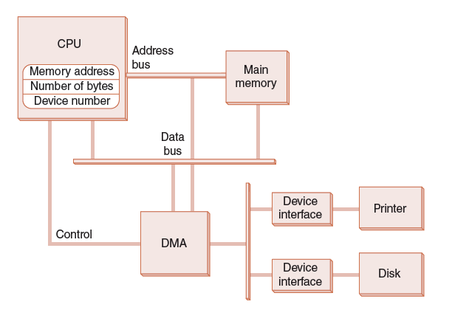
7.4 I/O Architectures (8 of 16)
This is a DMA configuration.
Notice that the DMA and the CPU share the bus.
The DMA runs at a higher priority and steals memory cycles from the CPU.

Slide 16
7.4 I/O Architectures (9 of 16)
Very large systems employ channel I/O.
Channel I/O consists of one or more I/O processors (IOPs) that control various channel paths.
Slower devices such as terminals and printers are combined (multiplexed) into a single faster channel.
On IBM mainframes, multiplexed channels are called multiplexor channels, the faster ones are called selector channels.

Slide 17
7.4 I/O Architectures (10 of 16)
Channel I/O is distinguished from DMA by the intelligence of the IOPs.
The IOP negotiates protocols, issues device commands, translates storage coding to memory coding, and can transfer entire files or groups of files independent of the host CPU.
The host has only to create the program instructions for the I/O operation and tell the IOP where to find them.

Slide 18
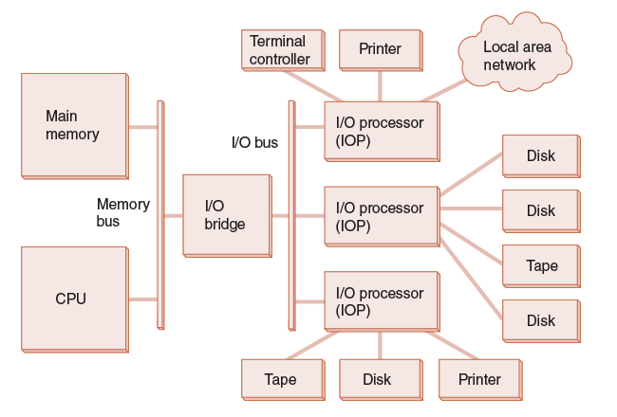
7.4 I/O Architectures (11 of 16)
This is a channel I/O configuration.

Slide 19
7.4 I/O Architectures (12 of 16)
Character I/O devices process one byte (or character) at a time.
Examples include modems, keyboards, and mice.
Keyboards are usually connected through an interrupt-driven I/O system.
Block I/O devices handle bytes in groups.
Most mass storage devices (disk and tape) are block I/O devices.
Block I/O systems are most efficiently connected through DMA or channel I/O.

Slide 20
7.4 I/O Architectures (13 of 16)
I/O buses, unlike memory buses, operate asynchronously. Requests for bus access must be arbitrated among the devices involved.
Bus control lines activate the devices when they are needed, raise signals when errors have occurred, and reset devices when necessary.
The number of data lines is the width of the bus.
A bus clock coordinates activities and provides bit cell boundaries.

Slide 21
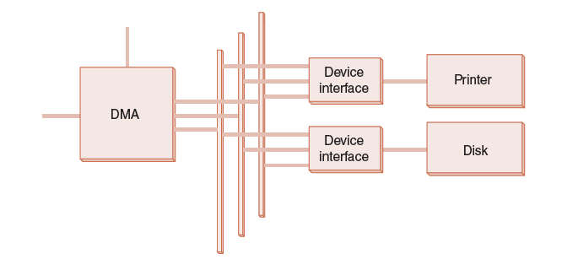
7.4 I/O Architectures (14 of 16)
This is a generic DMA configuration showing how the DMA circuit connects to a data bus.

Slide 22
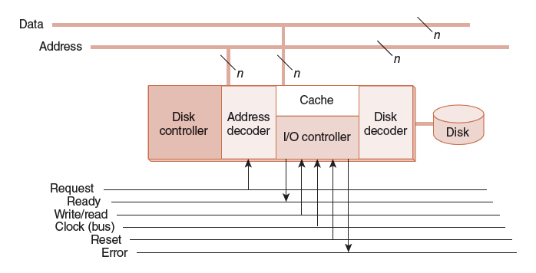
7.4 I/O Architectures (15 of 16)
This is how a bus connects to a disk drive.

Slide 23
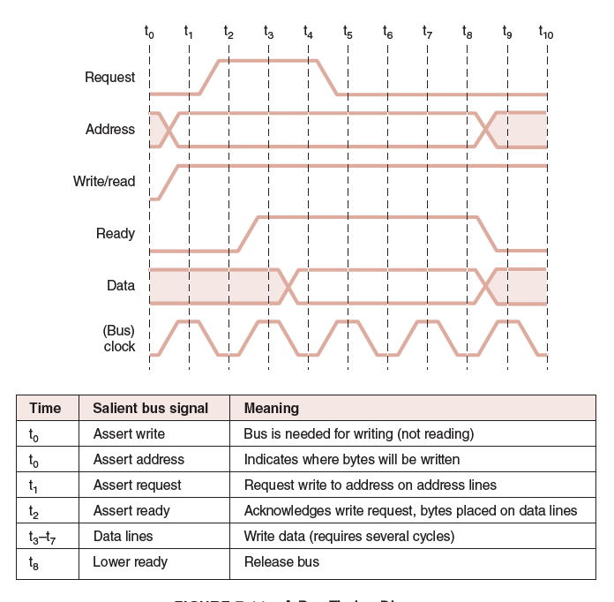
7.4 I/O Architectures (16 of 16)
Timing diagrams, such as this one, define bus operation in detail.

Slide 24
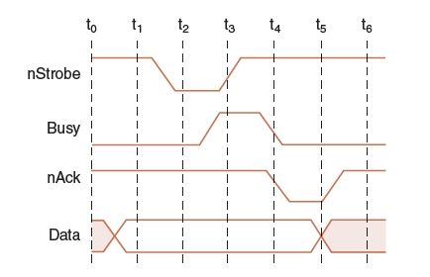
7.5 Data Transmission Modes (1 of 2)
Bytes can be conveyed from one point to another by sending their encoding signals simultaneously using parallel data transmission or by sending them one bit at a time in serial data transmission.
Parallel data transmission for a printer resembles the signal protocol of a memory bus:

Slide 25
7.5 Data Transmission Modes (2 of 2)
In parallel data transmission, the interface requires one conductor for each bit.
Parallel cables are fatter than serial cables.
Compared with parallel data interfaces, serial communications interfaces:
Require fewer conductors.
Are less susceptible to attenuation.
Can transmit data farther and faster.
Serial communications interfaces are suitable for time-sensitive (isochronous) data such as voice and video.

Slide 26
7.6 Disk Technology
Magnetic disks offer large amounts of durable storage that can be accessed quickly.
Disk drives are called random (or direct) access storage devices, because blocks of data can be accessed according to their location on the disk.
This term was coined when all other durable storage (e.g., tape) was sequential.
Magnetic disk organization is shown on the following slide.

Slide 27
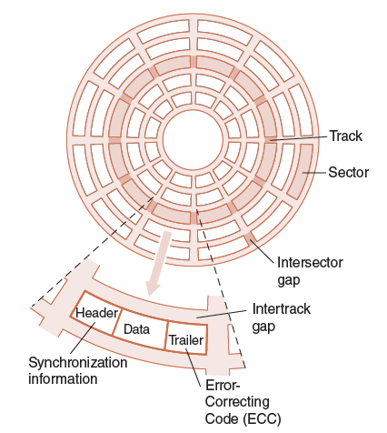
7.6.1 Rigid Disk Drives (1 of 6)
Disk tracks are numbered from the outside edge, starting with zero.

Slide 28
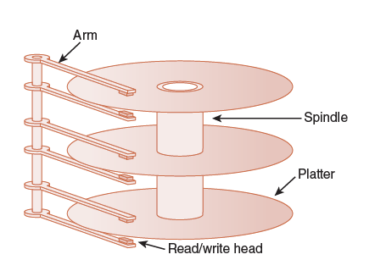
7.6.1 Rigid Disk Drives (2 of 6)
Hard disk platters are mounted on spindles.
Read/write heads are mounted on a comb that swings radially to read the disk.

Slide 29
7.6.1 Rigid Disk Drives (3 of 6)
The rotating disk forms a logical cylinder beneath the read/write heads.
Data blocks are addressed by their cylinder, surface, and sector.

Slide 30
7.6.1 Rigid Disk Drives (4 of 6)
There are a number of electromechanical properties of hard disk drives that determine how fast its data can be accessed.
Seek time is the time that it takes for a disk arm to move into position over the desired cylinder.
Rotational delay is the time that it takes for the desired sector to move into position beneath the read/write head.
Seek time + rotational delay = access time.

Slide 31
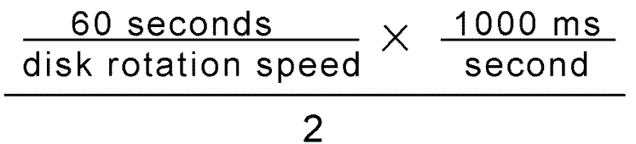
7.6.1 Rigid Disk Drives (5 of 6)
Transfer rate gives us the rate at which data can be read from the disk.
Average latency is a function of the rotational speed:
Mean Time To Failure (MTTF) is a statistically-determined value often calculated experimentally.
It usually doesn’t tell us much about the actual expected life of the disk. Design life is usually more realistic.
Figure 7.15 in the text shows a sample disk specification.

Slide 32
7.6.1 Rigid Disk Drives (6 of 6)
Low cost is the major advantage of hard disks.
But their limitations include:
Very slow compared to main memory
Fragility
Moving parts wear out
Reductions in memory cost enable the widespread adoption of solid state drives (SSDs).
Computers “see” SSDs as just another disk drive, but they store data in non-volatile flash memory circuits.
Flash memory is also found in memory sticks and MP3 players.

Slide 33
7.6.2 Solid State Drives (1 of 3)
SSD access time and transfer rates are typically 100 times faster than magnetic disk, but slower than onboard RAM by a factor of 100,000.
There numbers vary widely among manufacturers and interface methods.
Unlike RAM, flash is block-addressable (like disk drives).
The duty cycle of flash is between 30,000 and 1,000,000 updates to a block.
Updates are spread over the entire medium through wear leveling to prolong the life of the SSD.

Slide 34
7.6.2 Solid State Drives (2 of 3)
SSD specifications share many common metrics with HDDs.
Clearly, there is no need for any metrics that concern spinning platters, such as rotational delay.
Compare Figs 7.15 with 7.17 in your text.
Enterprise SSDs must maintain the highest degree of performance and reliability.
Onboard cache memories are backed up by capacitors that briefly hold a charge during a power failure, giving time to commit pending writes.

Slide 35
7.6.2 Solid State Drives (3 of 3)
The Joint Electron Devices Engineering Council (JEDEC) sets standards for SSD performance and reliability metrics. The most important are:
Unrecoverable Bit Error Ratio (UBER) and terabytes written (TBW). TBW is a measure of disk endurance (or service life) and UBER is a measure of disk reliability.
UBER is calculated by dividing the number of data errors by the number of bits read using a simulated lifetime workload.
TBW is the number of terabytes that can be written to the disk before the disk fails to meet specifications for speed and error rates.

Slide 36
7.7 Optical Disks (1 of 7)
Optical disks provide large storage capacities very inexpensively.
They come in a number of varieties including CD-ROM, DVD, and WORM.
Many large computer installations produce document output on optical disk rather than on paper. This idea is called COLD—Computer Output Laser Disk.
It is estimated that optical disks can endure for a hundred years. Other media are good for only a decade—at best.

Slide 37
7.7 Optical Disks (2 of 7)
CD-ROMs were designed by the music industry in the 1980s, and later adapted to data.
This history is reflected by the fact that data is recorded in a single spiral track, starting from the center of the disk and spanning outward.
Binary ones and zeros are delineated by bumps in the polycarbonate disk substrate. The transitions between pits and lands define binary ones.
If you could unravel a full CD-ROM track, it would be nearly 5 miles long!

Slide 38
7.7 Optical Disks (3 of 7)
The logical data format for a CD-ROM is much more complex than that of a magnetic disk. (See the text for details.)
Different formats are provided for data and music.
Two levels of error correction are provided for the data format.
Because of this, a CD holds at most 650MB of data, but can contain as much as 742MB of music.

Slide 39
7.7 Optical Disks (4 of 7)
DVDs can be thought of as quad-density CDs.
Varieties include single sided, single layer, single sided double layer, double sided double layer, and double sided double layer.
Where a CD-ROM can hold at most 650MB of data, DVDs can hold as much as 17GB.
One of the reasons for this is that DVD employs a laser that has a shorter wavelength than the CD’s laser.
This allows pits and lands to be closer together and the spiral track to be wound tighter.

Slide 40
7.7 Optical Disks (5 of 7)
A shorter wavelength light can read and write bytes in greater densities than can be done by a longer wavelength laser.
This is one reason that DVD’s density is greater than that of CD.
The 405 nm wavelength of blue-violet light is much shorter than either red (750 nm) or orange (650 nm).
The manufacture of blue-violet lasers can now be done economically, bringing about the next generation of laser disks.

Slide 41
7.7 Optical Disks (6 of 7)
The Blu-Ray disc format won market dominance over HD-CD owing mainly to the influence of Sony.
HD-CDs are backward compatible with DVD, but hold less data.
Blu-Ray was developed by a consortium of nine companies that includes Sony, Samsung, and Pioneer.
Maximum capacity of a single layer Blu-Ray disk is 25GB.
Multiple layers can be “stacked” up to six deep.
Only double-layer disks are available for home use.

Slide 42
7.7 Optical Disks (7 of 7)
Blue-violet laser disks are also used in the data center.
The intention is to provide a means for long term data storage and retrieval.
Two types are now dominant:
Sony’s Professional Disk for Data (PDD) that can store 23GB on one disk
Plasmon’s Ultra Density Optical (UDO) that can hold up to 30GB
It is too soon to tell which of these technologies will emerge as the winner.

Slide 43
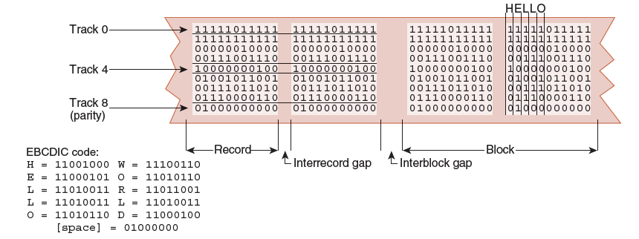
7.8 Magnetic Tape (1 of 6)
First-generation magnetic tape was not much more than wide analog recording tape, having capacities under 11MB.
Data was usually written in nine vertical tracks:

Slide 44
7.8 Magnetic Tape (2 of 6)
Today’s tapes are digital, and provide multiple gigabytes of data storage.
Two dominant recording methods are serpentine and helical scan, which are distinguished by how the read-write head passes over the recording medium.
Serpentine recording is used in digital linear tape (DLT) and quarter inch cartridge (QIC) tape systems.
Digital audio tape (DAT) systems employ helical scan recording.
These two recording methods are shown on the next slide.

Slide 45

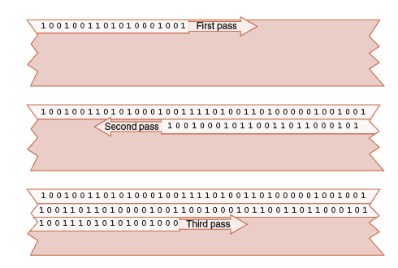
7.8 Magnetic Tape (3 of 6)
← Serpentine

Slide 46
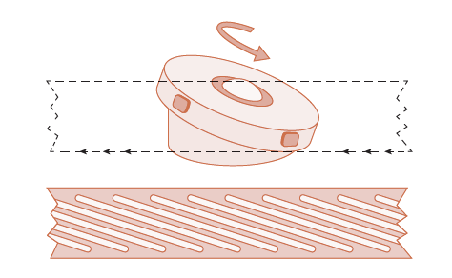
7.8 Magnetic Tape (4 of 6)
Helical Scan →

Slide 47
7.8 Magnetic Tape (5 of 6)
Numerous incompatible tape formats emerged over the years.
Sometimes even different models of the same manufacturer’s tape drives were incompatible!
Finally, in 1997, HP, IBM, and Seagate collaboratively invented a best-of-breed tape standard.
They called this new tape format Linear Tape Open (LTO) because the specification is openly available.

Slide 48
7.8 Magnetic Tape (6 of 6)
LTO, as the name implies, is a linear digital tape format.
The specification allowed for the refinement of the technology through four “generations.”
Generation 5 was released in 2010.
Without compression, the tapes support a transfer rate of 208MB per second and each tape can hold up to 1.4TB.
LTO supports several levels of error correction, providing superb reliability.
Tape has a reputation for being an error-prone medium.

Slide 49
7.9 RAID (1 of 11)
RAID, an acronym for Redundant Array of Independent Disks was invented to address problems of disk reliability, cost, and performance.
In RAID, data is stored across many disks, with extra disks added to the array to provide error correction (redundancy).
The inventors of RAID, David Patterson, Garth Gibson, and Randy Katz, provided a RAID taxonomy that has persisted for a quarter of a century, despite many efforts to redefine it.

Slide 50
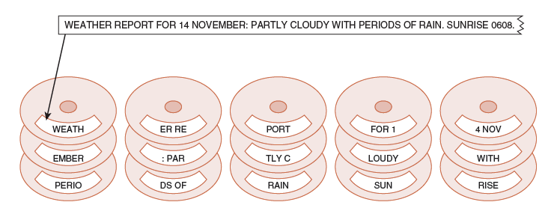
7.9 RAID (2 of 11)
RAID Level 0, also known as drive spanning, provides improved performance, but no redundancy.
Data is written in blocks across the entire array.
The disadvantage of RAID 0 is in its low reliability.

Slide 51
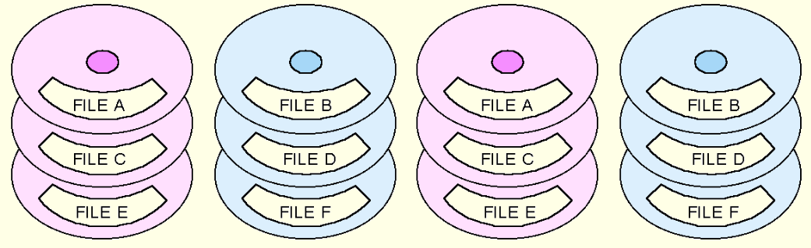
7.9 RAID (3 of 11)
RAID Level 1, also known as disk mirroring, provides 100% redundancy, and good performance.
Two matched sets of disks contain the same data.
The disadvantage of RAID 1 is cost.

Slide 52
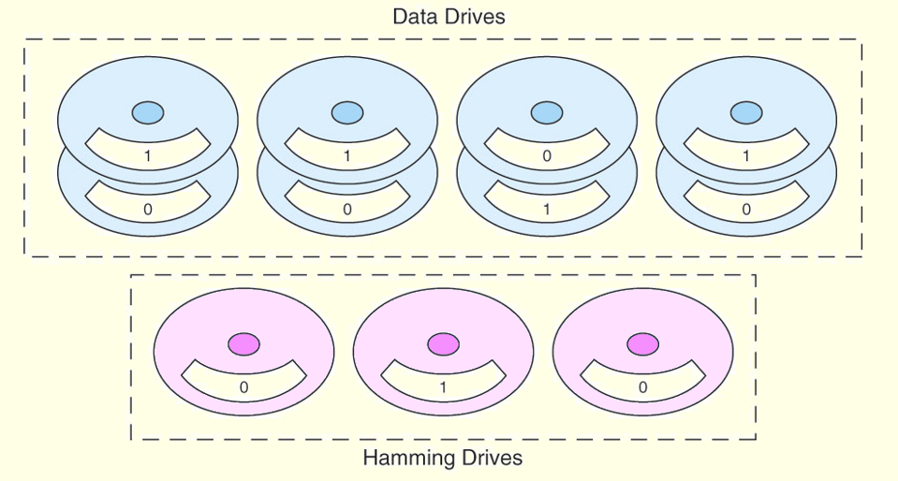
7.9 RAID (4 of 11)
A RAID Level 2 configuration consists of a set of data drives, and a set of Hamming code drives.
Hamming code drives provide error correction for the data drives.
RAID 2 performance is poor and the cost is relatively high.

Slide 53
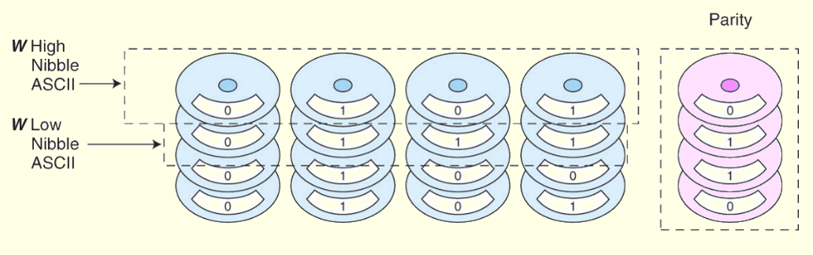
7.9 RAID (5 of 11)
RAID Level 3 stripes bits across a set of data drives and provides a separate disk for parity.
Parity is the XOR of the data bits.
RAID 3 is not suitable for commercial applications, but is good for personal systems.

Slide 54
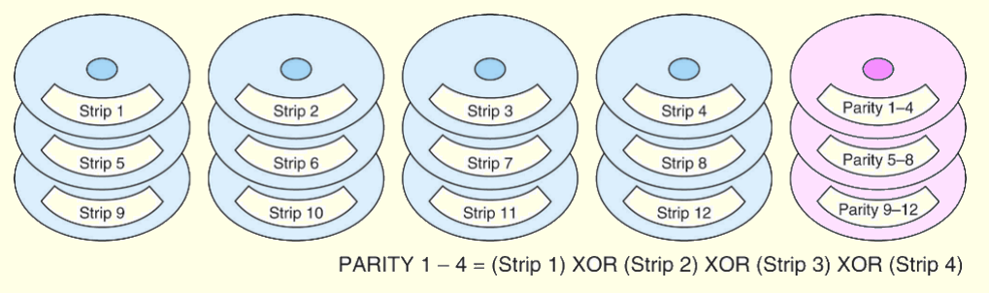
7.9 RAID (6 of 11)
RAID Level 4 is like adding parity disks to RAID 0.
Data is written in blocks across the data disks, and a parity block is written to the redundant drive.
RAID 4 would be feasible if all record blocks were the same size.

Slide 55
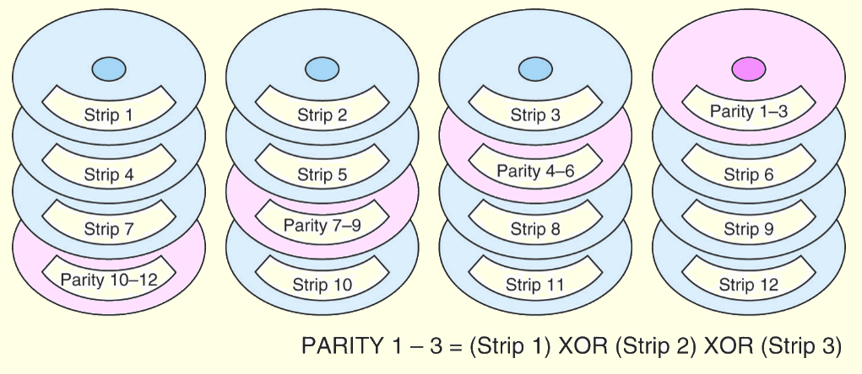
7.9 RAID (7 of 11)
RAID Level 5 is RAID 4 with distributed parity.
With distributed parity, some accesses can be serviced concurrently, giving good performance and high reliability.
RAID 5 is used in many commercial systems.

Slide 56
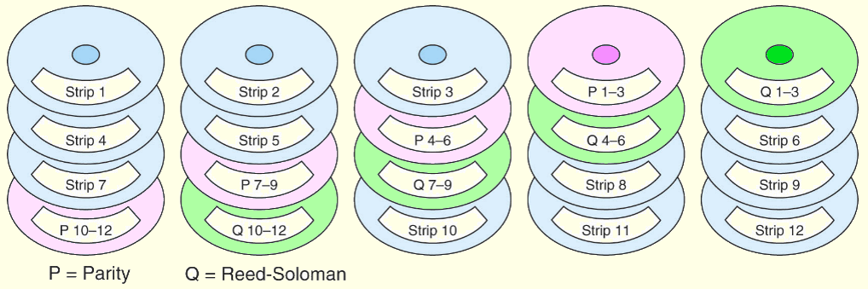
7.9 RAID (8 of 11)
RAID Level 6 carries two levels of error protection over striped data: Reed-Soloman and parity.
It can tolerate the loss of two disks.
RAID 6 is write-intensive, but highly fault-tolerant.

Slide 57
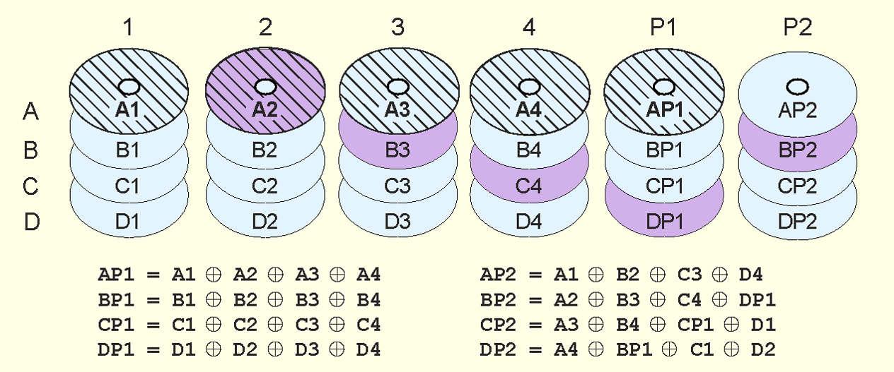
7.9 RAID (9 of 11)
Double parity RAID (RAID DP) employs pairs of over- lapping parity blocks that provide linearly independent parity functions.

Slide 58
7.9 RAID (10 of 11)
Like RAID 6, RAID DP can tolerate the loss of two disks.
The use of simple parity functions provides RAID DP with better performance than RAID 6.
Of course, because two parity functions are involved, RAID DP’s performance is somewhat degraded from that of RAID 5.
RAID DP is also known as EVENODD, diagonal parity RAID, RAID 5DP, advanced data guarding RAID (RAID ADG) and—erroneously—RAID 6.

Slide 59
7.9 RAID (11 of 11)
Large systems consisting of many drive arrays may employ various RAID levels, depending on the criticality of the data on the drives.
A disk array that provides program workspace (say for file sorting) does not require high fault tolerance.
Critical, high-throughput files can benefit from combining RAID 0 with RAID 1, called RAID 10.
RAID 50 combines striping and distributed parity. For good fault tolerance and high capacity.
Note: Higher RAID levels do not necessarily mean “better” RAID levels. It all depends upon the needs of the applications that use the disks.

Slide 60
7.10 The Future of Data Storage (1 of 11)
Advances in technology have defied all efforts to define the ultimate upper limit for magnetic disk storage.
In the 1970s, the upper limit was thought to be around 2MB/in².
Today’s disks commonly support 20GB/in².
Improvements have occurred in several different technologies including:
Materials science.
Magneto-optical recording heads.
Error correcting codes.

Slide 61
7.10 The Future of Data Storage (2 of 11)
As data densities increase, bit cells consist of proportionately fewer magnetic grains.
There is a point at which there are too few grains to hold a value, and a 1 might spontaneously change to a 0, or vice versa.
This point is called the superparamagnetic limit.
In 2006, the superparamagnetic limit is thought to lie between 150GB/in² and 200GB/in².
Even if this limit is wrong by a few orders of magnitude, the greatest gains in magnetic storage have probably already been realized.

Slide 62
7.10 The Future of Data Storage (3 of 11)
Future exponential gains in data storage most likely will occur through the use of totally new technologies.
Research into finding suitable replacements for magnetic disks is taking place on several fronts.
Some of the more interesting technologies include:
Biological materials
Holographic systems
Micro-electro-mechanical devices
Carbon nanotubes
Memristors

Slide 63
7.10 The Future of Data Storage (4 of 11)
Present day biological data storage systems combine organic compounds such as proteins or oils with inorganic (magnetizable) substances.
Early prototypes have encouraged the expectation that densities of 1Tb/in² are attainable.
Of course, the ultimate biological data storage medium is DNA.
Trillions of messages can be stored in a tiny strand of DNA.
Practical DNA-based data storage is most likely decades away.

Slide 64
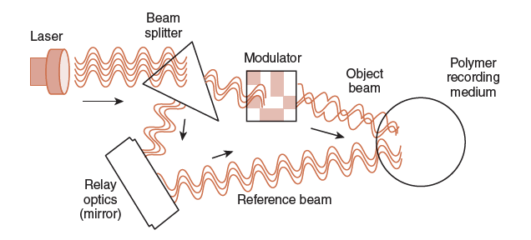
7.10 The Future of Data Storage (5 of 11)
Holographic storage uses a pair of laser beams to etch a three-dimensional hologram onto a polymer medium.

Slide 65
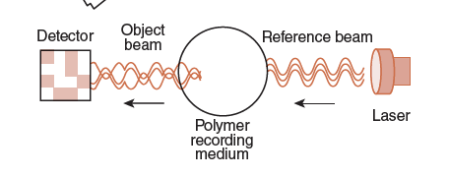
7.10 The Future of Data Storage (6 of 11)
Data is retrieved by passing the reference beam through the hologram, thereby reproducing the original coded object beam.

Slide 66
7.10 The Future of Data Storage (7 of 11)
Because holograms are three-dimensional, tremendous data densities are possible.
Experimental systems have achieved over 30GB/in2, with transfer rates of around 1GBps.
In addition, holographic storage is content addressable.
This means that there is no need for a file directory on the disk. Accordingly, access time is reduced.
The major challenge is in finding an inexpensive, stable, rewriteable holographic medium.

Slide 67
7.10 The Future of Data Storage (8 of 11)
Micro-electro-mechanical storage (MEMS) devices offer another promising approach to mass storage.
IBM’s Millipede is one such device.
Prototypes have achieved densities of 100GB/in² with 1Tb/in² expected as the technology is refined.
A photomicrograph of Millipede is shown on the next slide.

Slide 68
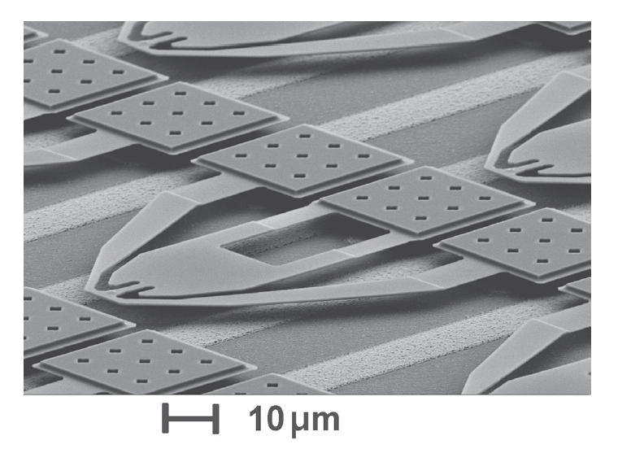
7.10 The Future of Data Storage (9 of 11)
Millipede consists of thousands of cantilevers that record a binary 1 by pressing a heated tip into a polymer substrate.
The tip reads a binary 1 when it dips into the imprint in the polymer.

Slide 69
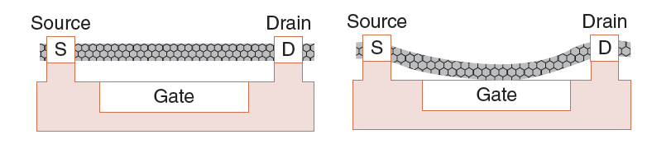
7.10 The Future of Data Storage (10 of 11)
CNTs are a cylindrical form of elemental carbon: The walls of the cylinders are one atom thick.
CNTs can act like switches, opening and closing to store bits.
Once “set” the CNT stays in place until a release voltage is applied.

Slide 70
7.10 The Future of Data Storage (11 of 11)
Memristors are electronic components that combine the properties of a resistor with memory.
Resistance to current flow can be controlled so that states of “high” and “low” store data bits.
Like CNTs, memristor memories are non-volatile, holding their state until certain threshold voltages are applied.
These non-volatile memories promise enormous energy savings and increased data access speeds in the very near future.

Slide 71
Conclusion (1 of 3)
I/O systems are critical to the overall performance of a computer system.
Amdahl’s Law quantifies this assertion.
I/O systems consist of memory blocks, cabling, control circuitry, interfaces, and media.
I/O control methods include programmed I/O, interrupt-based I/O, DMA, and channel I/O.
Buses require control lines, a clock, and data lines. Timing diagrams specify operational details.

Slide 72
Conclusion (2 of 3)
Magnetic disk is the principal form of durable storage.
Disk performance metrics include seek time, rotational delay, and reliability estimates.
Enterprise SSDs save energy and provide improved data access for government and industry.
Optical disks provide long-term storage for large amounts of data, although access is slow.
Magnetic tape is also an archival medium sill widely used.

Slide 73
Conclusion (3 of 3)
RAID gives disk systems improved performance and reliability. RAID 3 and RAID 5 are the most common.
RAID 6 and RAID DP protect against dual disk failure, but RAID DP offers better performance.
Any one of several new technologies including biological, holographic, CNT, memristor, or mechanical may someday replace magnetic disks.
The hardest part of data storage may be in locating the data after it’s stored.

